Slide 1
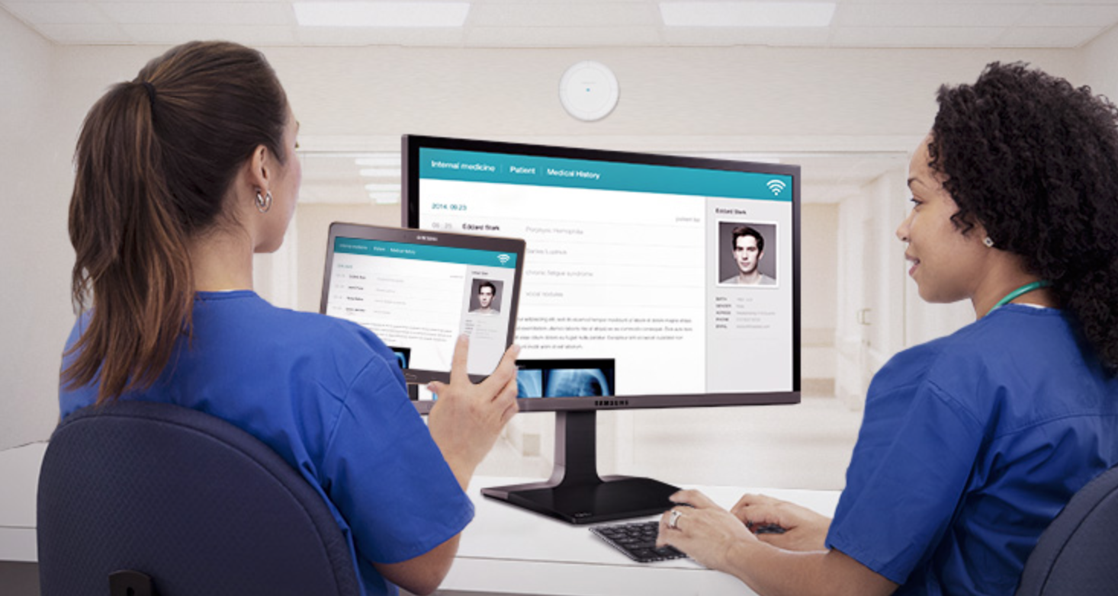
Patient Record System
Presented by: Darshan Nayee, Karan Nayee, Jasmine Buttar
December 11th, 2017
CSC225-01

Slide 2
Introduction:
The Patient Record System is an Integrated Hospital Information System, which addresses all the major functions of the multi-specialty hospitals. It enables better patient care, patient safety, patient confidentiality, efficiency, reduced costs and better management information system. It keeps track of the staff and patient (in-patient, out-patient) details. It also takes care of the ward, invoice and the doctor’s appointment details. This project sincerely aims to reduce the manual processing of each department.
Darshan Nayee, Karan Nayee, Jasmine Buttar
Csc225-01
Slide Number-1
December 13th,2017

Slide 3
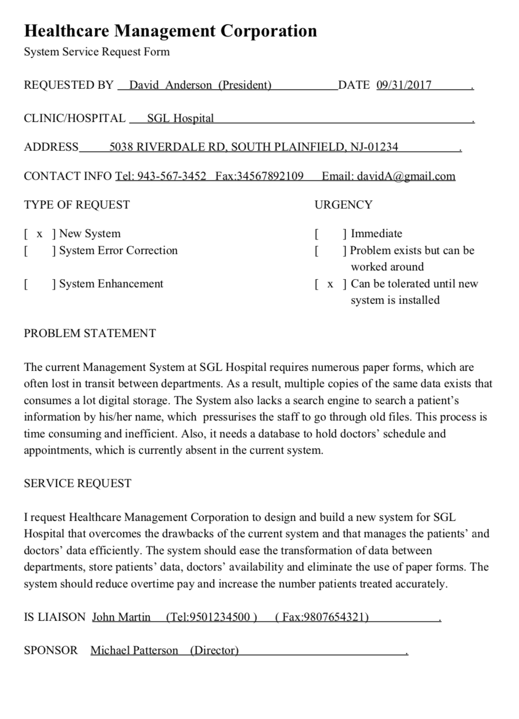
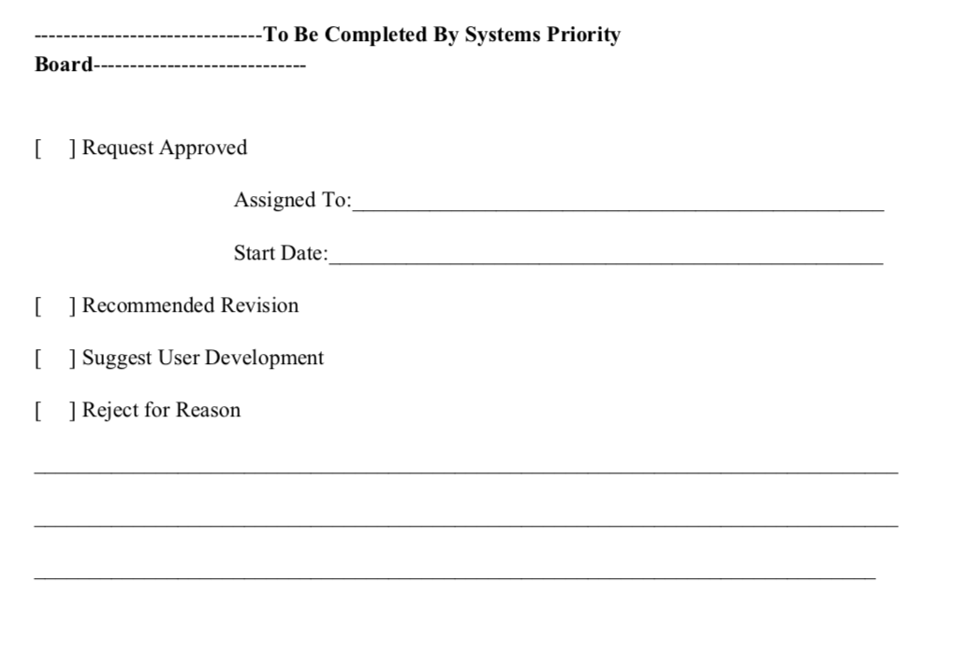
System Service Request: By Jasmine Buttar
Darshan Nayee, Karan Nayee, Jasmine Buttar
Csc225-01
Slide Number – 2
December 13th, 2017

Slide 4
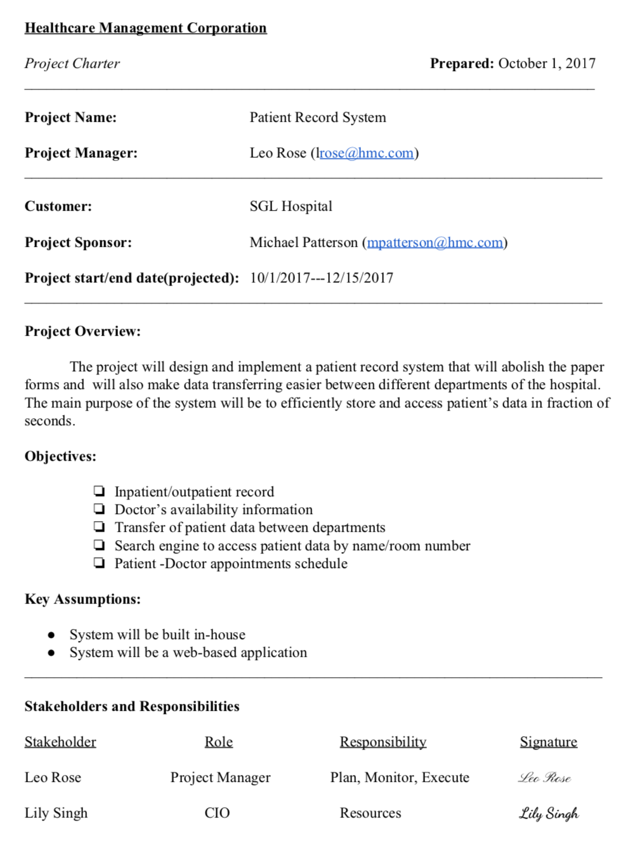
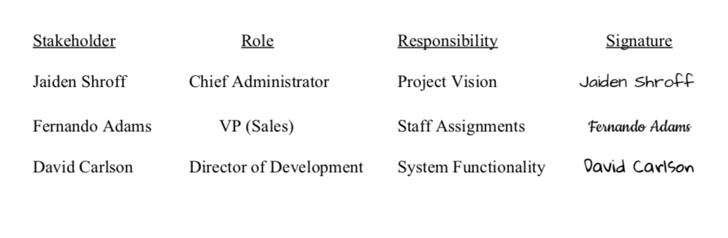
Project Charter: By Jasmine Buttar
Darshan Nayee, Karan Nayee, Jasmine Buttar
Csc225-01
Slide Number-3
December 13th, 2017

Slide 5
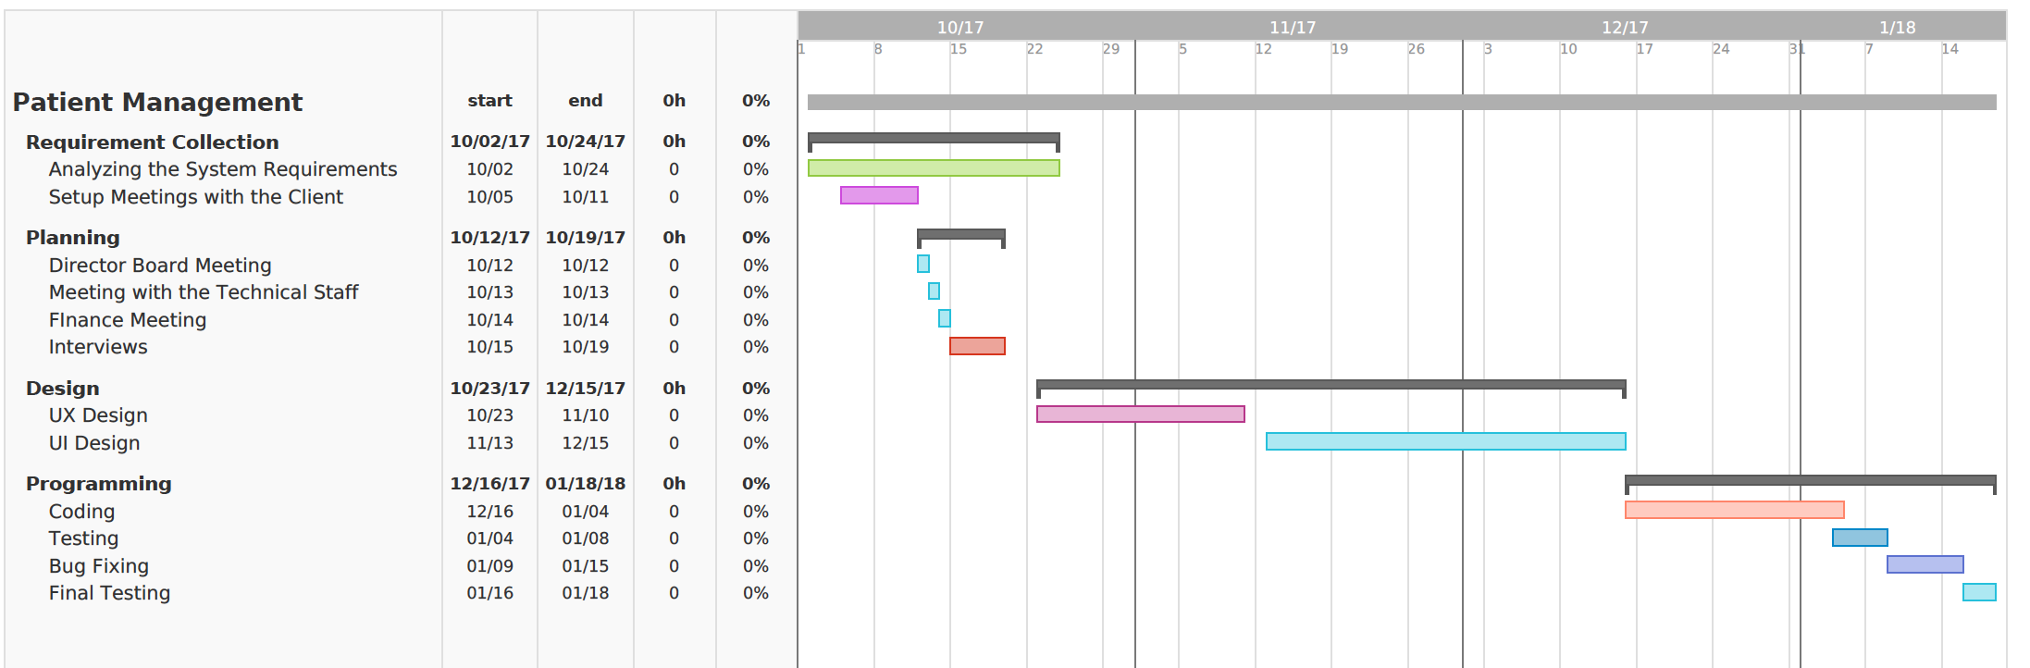
Gantt Chart: By Darshan Nayee
Darshan Nayee, Karan Nayee, Jasmine Buttar
Csc225-01
Slide Number-4
December 13th, 2017

Slide 6
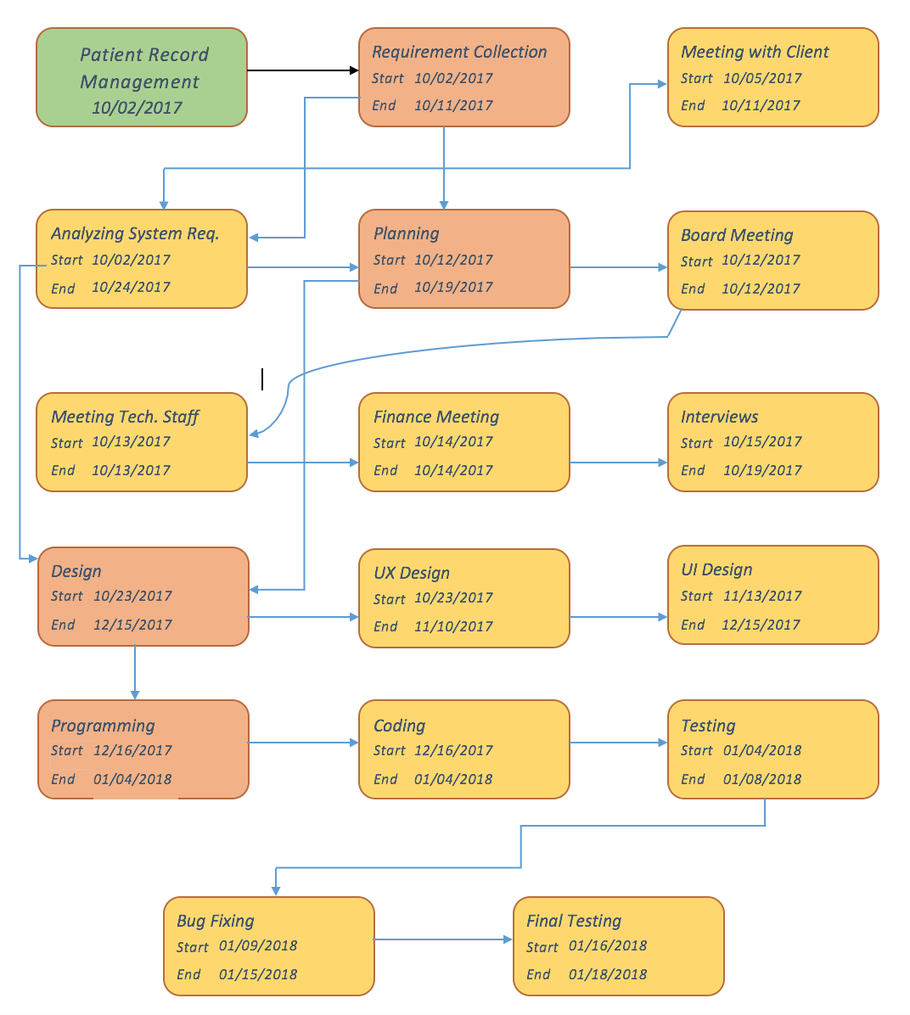
Network Diagram: By Darshan Nayee & Karan Nayee
Darshan Nayee, Karan Nayee, Jasmine Buttar
Csc225-01
Slide Number-5
December 13th, 2017

Slide 7
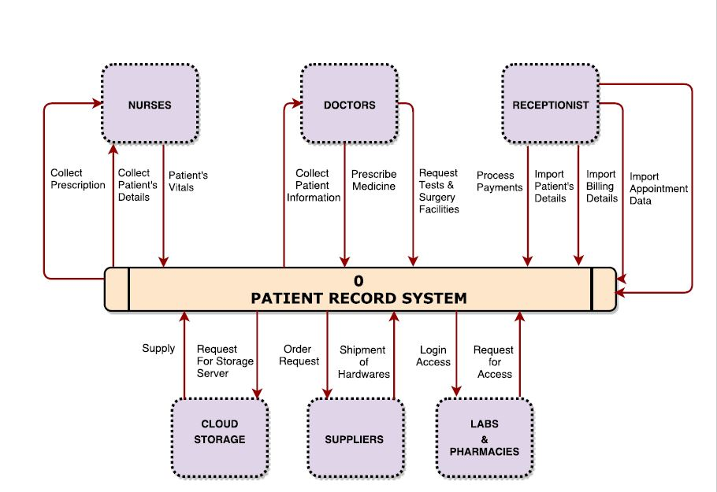
Context Level Data Flow Diagram: By Darshan Nayee, Karan Nayee, Jasmine Buttar
Darshan Nayee, Karan Nayee, Jasmine Buttar
Csc225-01
Slide Number-6
December 13th, 2017

Slide 8
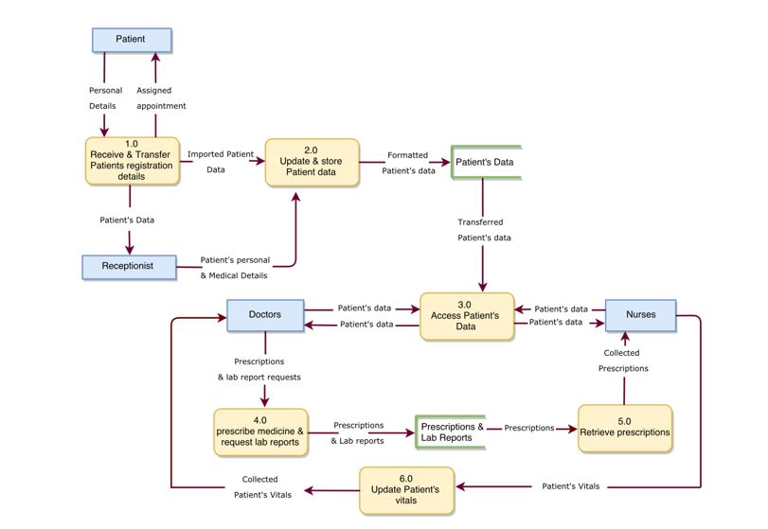
Level-0 Data Flow Diagram: By Darshan Nayee, Karan Nayee, Jasmine Buttar
Darshan Nayee, Karan Nayee, Jasmine Buttar
Csc225-01
Slide Number-7
December 13th, 2017

Slide 9
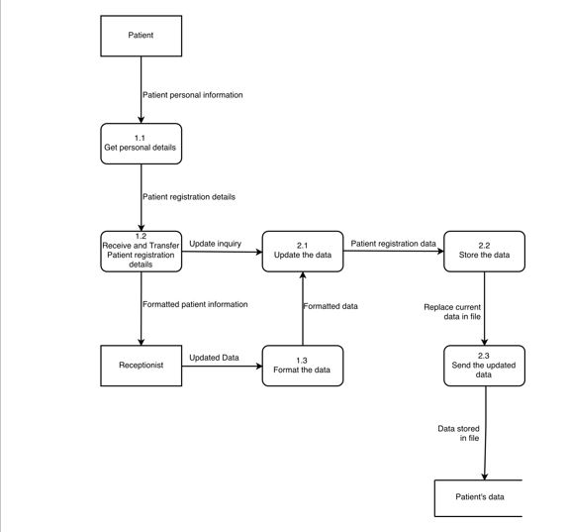
Level-1 Data Flow Diagram For Processes 1.0 (Receive and Transfer Patient Registration Details) and 2.0 (Update and Store Patient Data) by Darshan Nayee
Darshan Nayee, Karan Nayee, Jasmine Buttar
Csc225-01
Slide Number-8
December 13th, 2017

Slide 10
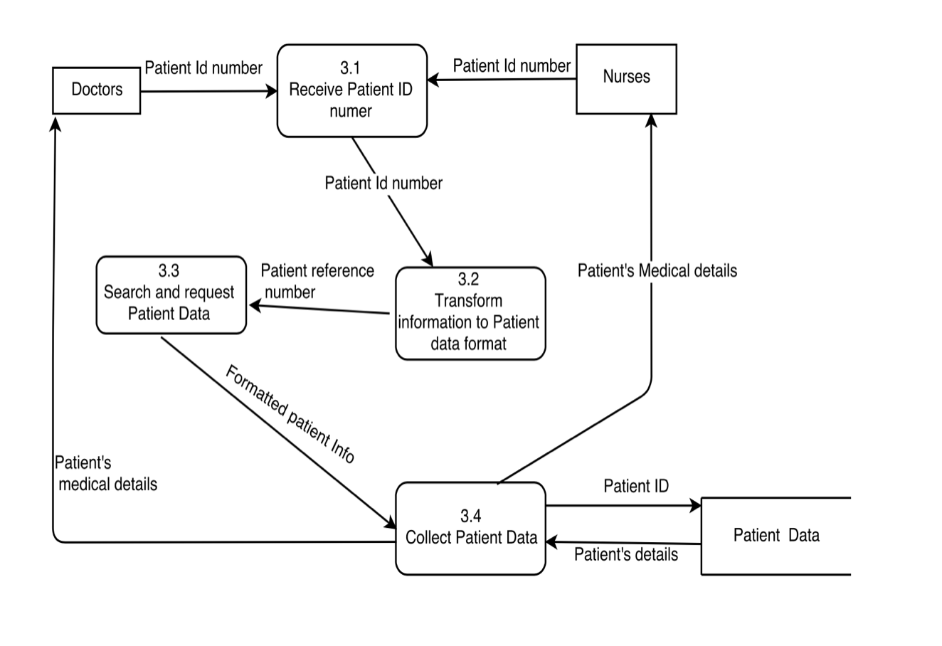
Level-1 Data Flow Diagram for Process 3.0 (Access Patient Data) By Jasmine Buttar
Darshan Nayee, Karan Nayee, Jasmine Buttar
Csc225-01
Slide Number-9
December 13th, 2017

Slide 11
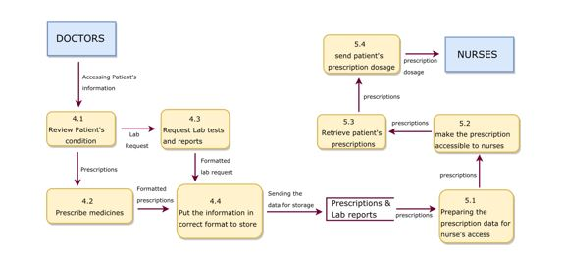
Level-1 Data Flow Diagram for Processes 4.0 (Prescribe Medicines and Request Lab Reports) and 5.0 (Retrieve Prescriptions) By Karan Nayee
Darshan Nayee, Karan Nayee, Jasmine Buttar
Csc225-01
Slide Number-10
December 13th, 2017

Slide 12
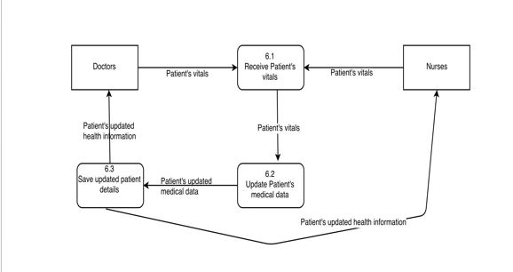
Level-1 Data Flow Diagram for Process 6.0 (Update Patient's Vitals) By Jasmine Buttar
Darshan Nayee, Karan Nayee, Jasmine Buttar
Csc225-01
Slide Number-11
December 13th, 2017

Slide 13
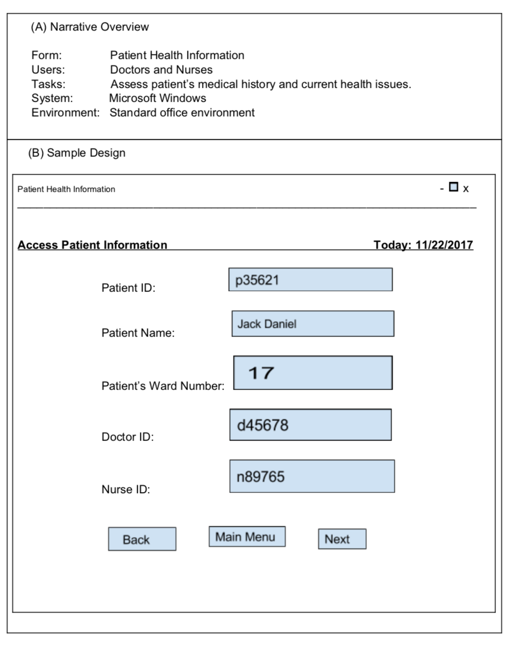
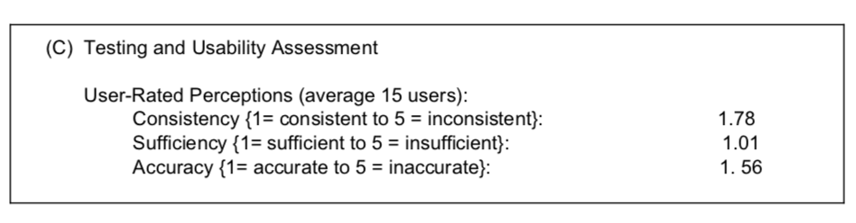
Design Specifications for Patient Health Information Form (For Dialogue 3-Access Patient Data): By Jasmine Buttar
Darshan Nayee, Karan Nayee, Jasmine Buttar
Csc225-12
Slide Number-12
December 13th, 2017

Slide 14
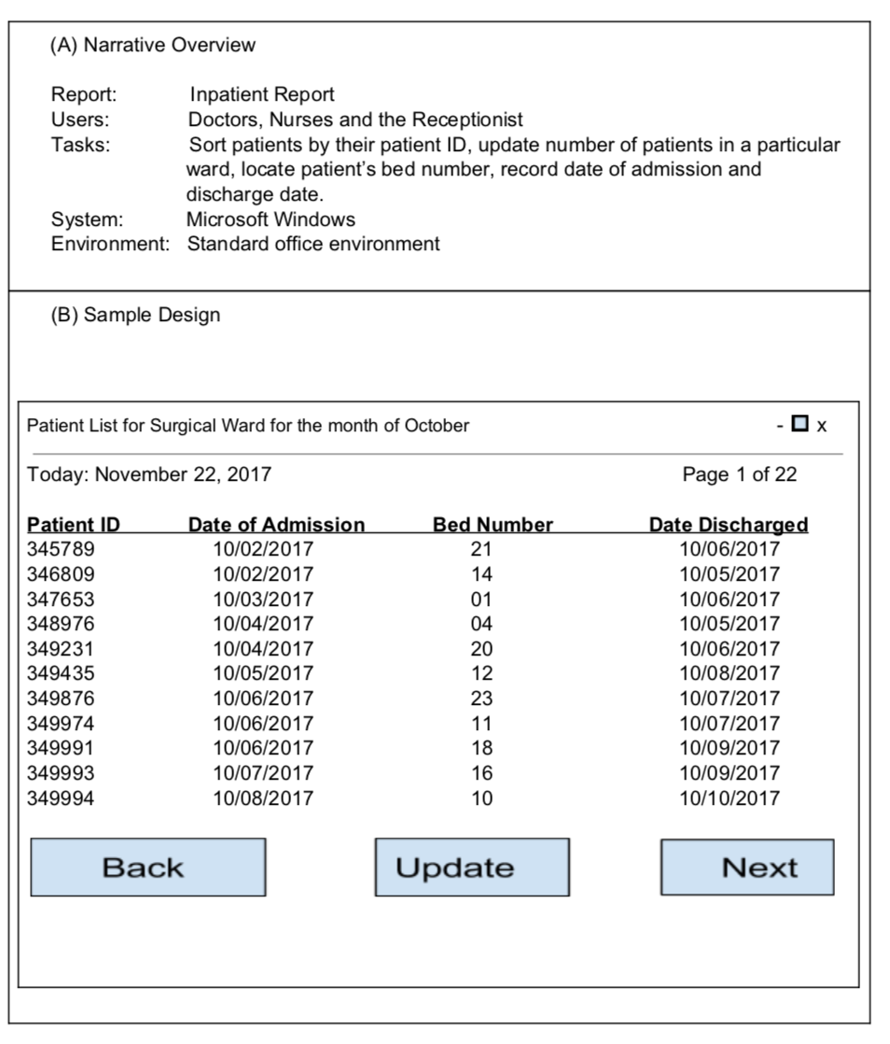
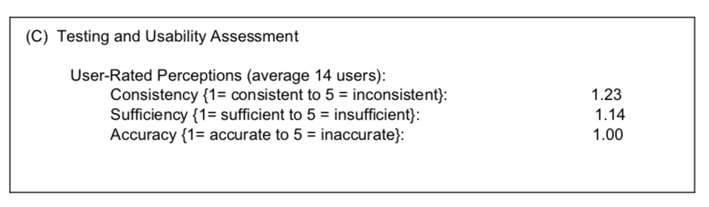
Design Specifications for Inpatient Report: By Jasmine Buttar
Darshan Nayee, Karan Nayee, Jasmine Buttar
Csc225-01
Slide Number-13
December 13th, 2017

Slide 15
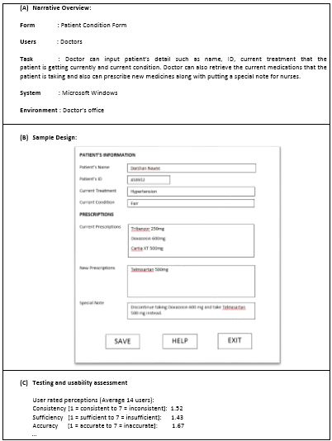
Design Specifications for Patient Condition Form: By Karan Nayee
Darshan Nayee, Karan Nayee, Jasmine Buttar
Csc225-01
Slide Number-14
December 13th, 2017

Slide 16
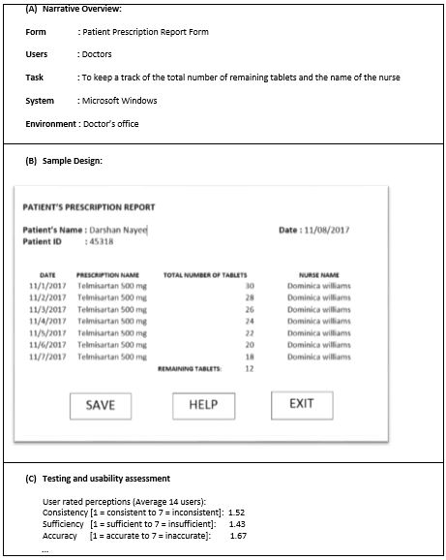
Design Specifications for Patient Prescription Report Form: By Karan Nayee
Darshan Nayee, Karan Nayee, Jasmine Buttar
Csc225-01
Slide Number-15
December 13th, 2017

Slide 17
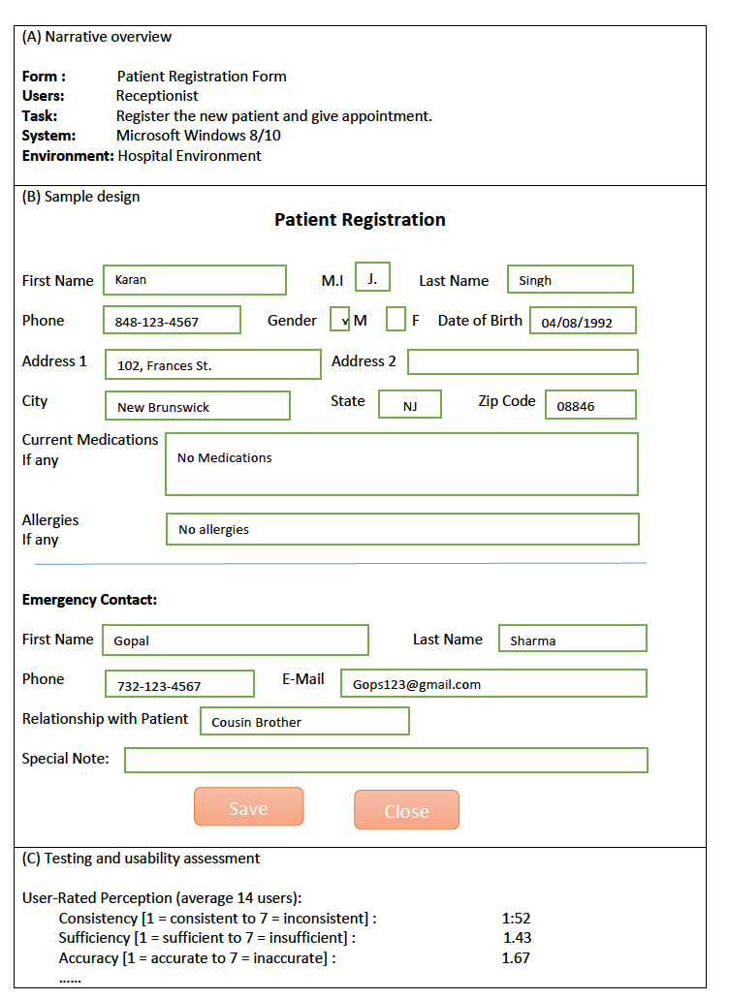
Design Specifications for Patient Registration Form By Darshan Nayee
Darshan Nayee, Karan Nayee, Jasmine Buttar
Csc225-01
Slide Number-16
December 13th, 2017

Slide 18
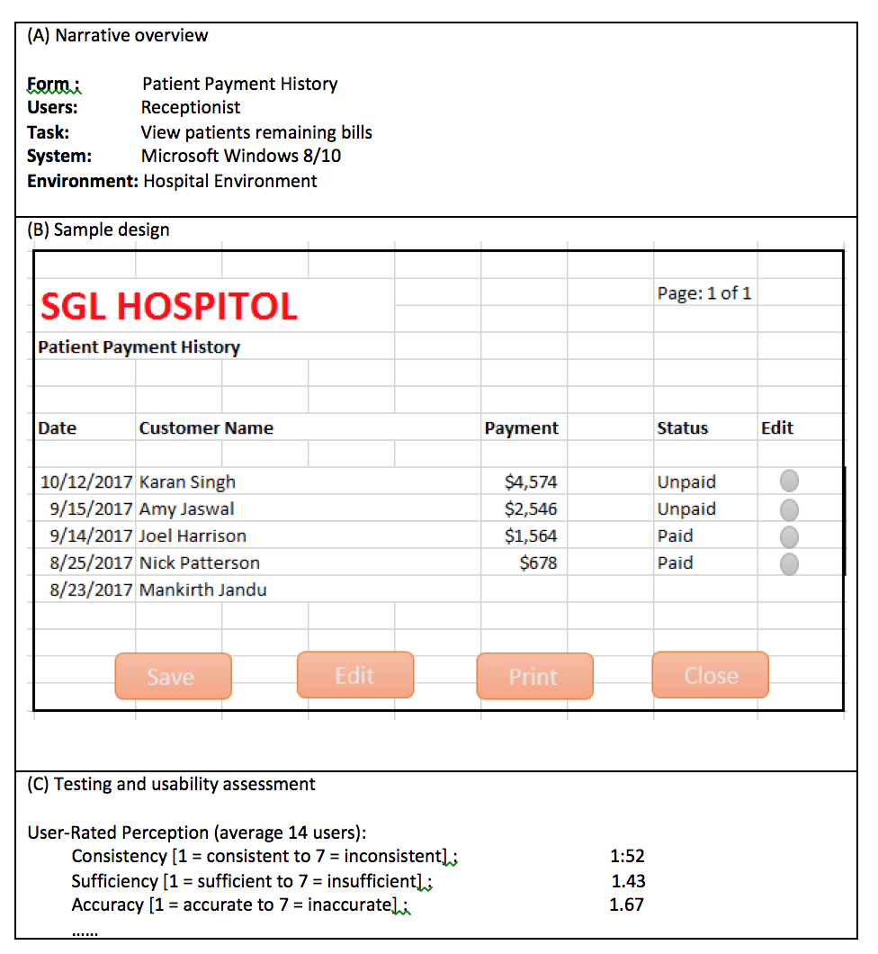
Design Specifications for Patient’s payment history: By Darshan Nayee
Darshan Nayee, Karan Nayee, Jasmine Buttar
Csc225-01
Slide Number-17
December 13th, 2017

Slide 19
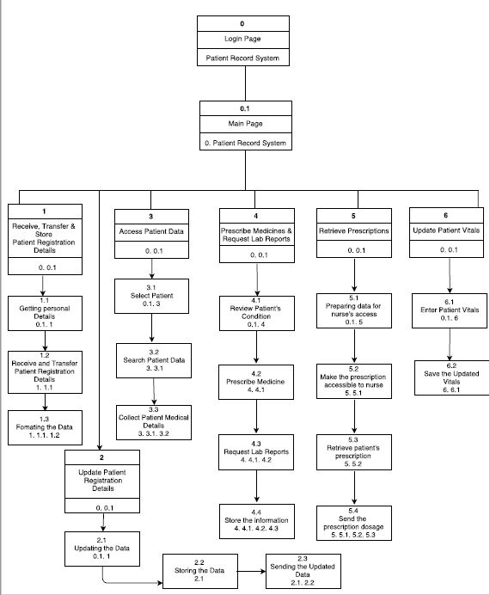
Dialogue Diagram: By Darshan Nayee, Karan Nayee, Jasmine Buttar
Darshan Nayee, Karan Nayee, Jasmine Buttar
Csc225-01
Slide Number-18
December 13th, 2017

Slide 20
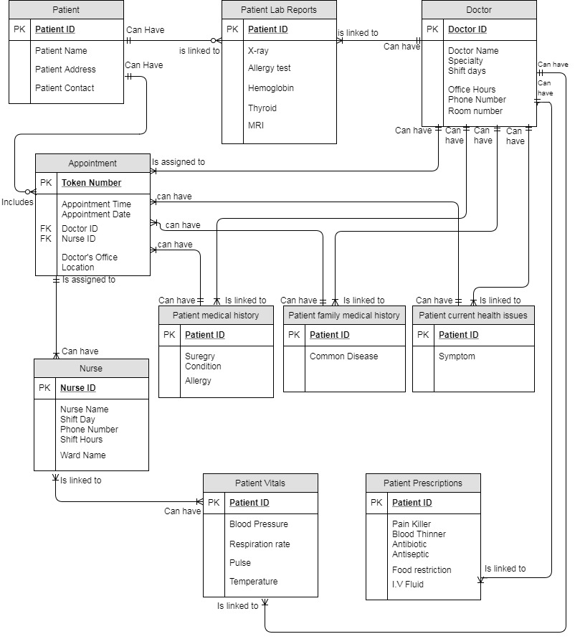
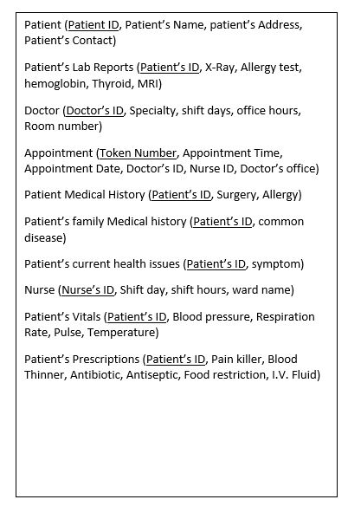
Entity Relationship Diagram Normalized to 3NF By Darshan Nayee, Karan Nayee, Jasmine Buttar
Darshan Nayee, Karan Nayee, Jasmine Buttar
Csc225-01
Slide Number-19
December 13th, 2017

Slide 21
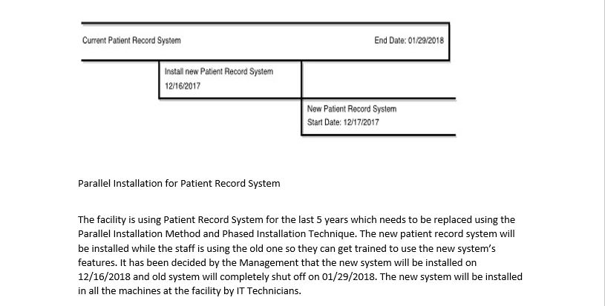
Installation Plan: By Darshan Nayee, Karan Nayee, Jasmine Buttar
Darshan Nayee, Karan Nayee, Jasmine Buttar
Csc225-01
Slide Number-20
December 13th, 2017

Slide 22
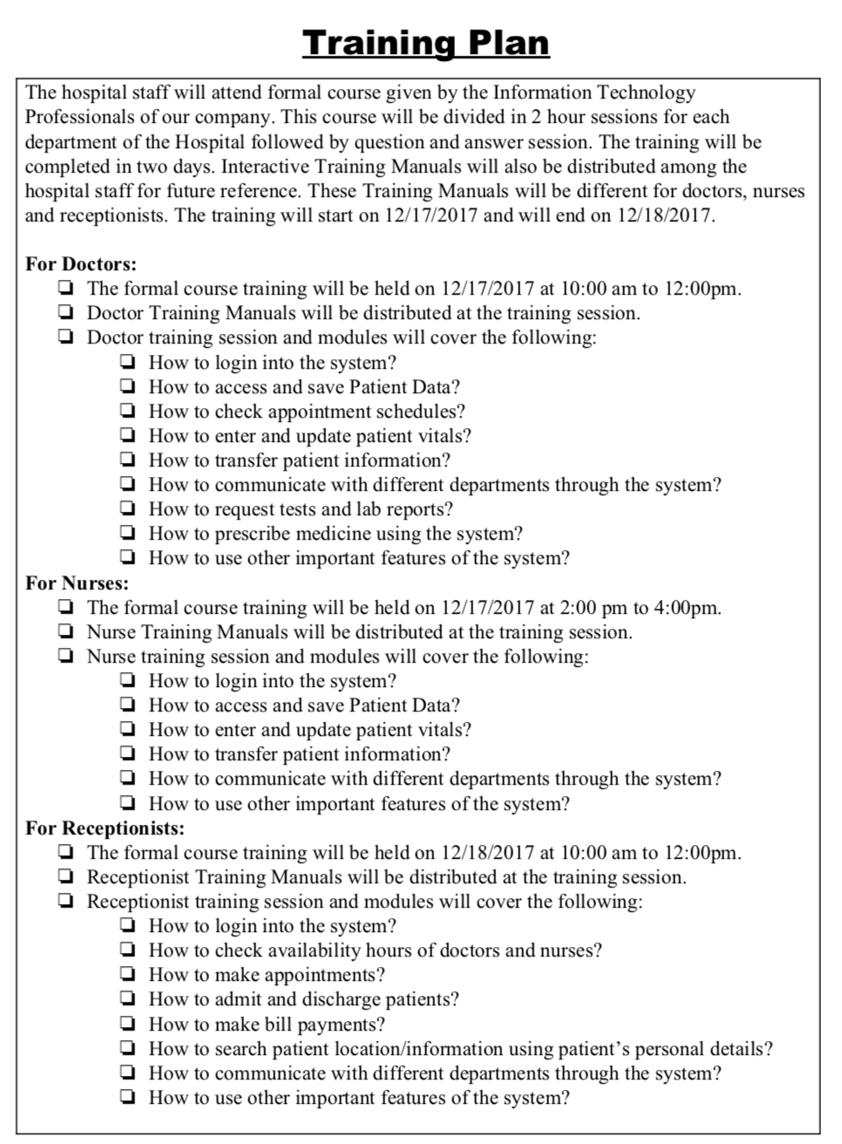
Training Plan: By Darshan Nayee, Karan Nayee, Jasmine Buttar
Darshan Nayee, Karan Nayee, Jasmine Buttar
Csc225-01
Slide Number-21
December 13th, 2017

Slide 23
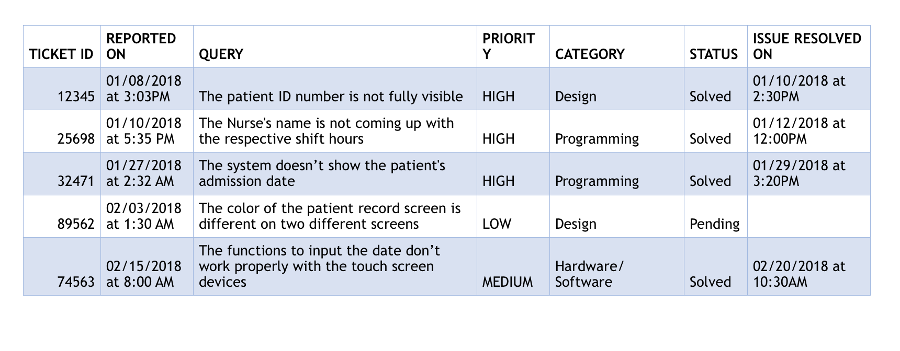
Issue Tracking Plan: By Darshan Nayee, Karan Nayee, Jasmine Buttar
Darshan Nayee, Karan Nayee, Jasmine Buttar
Csc225-01
Slide Number-22
December 13th, 2017

Slide 24
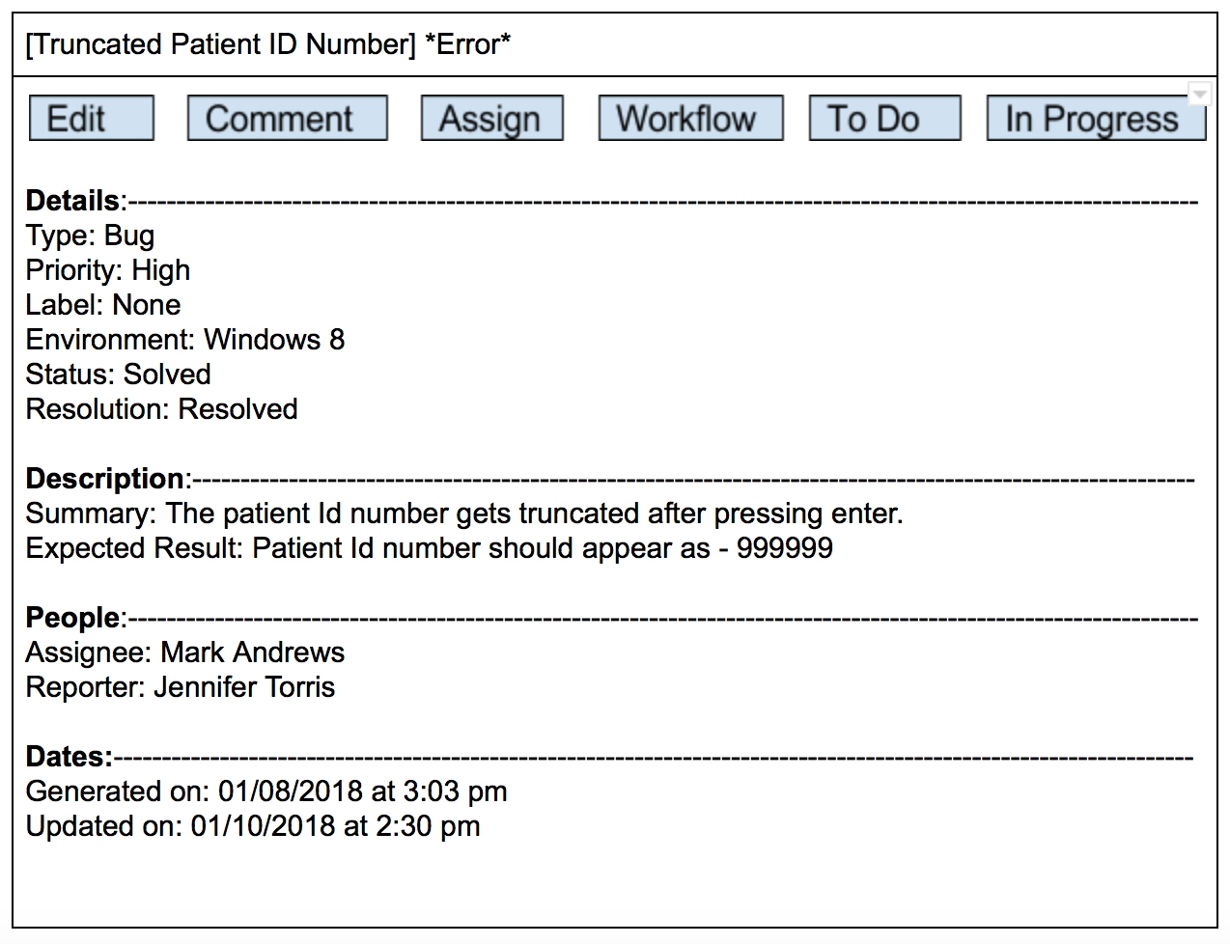
Error Screen: Patient ID number not fully visible By Jasmine Buttar
Darshan Nayee, Karan Nayee, Jasmine Buttar
Csc225-01
Slide Number-23
December 13th, 2017

Slide 25
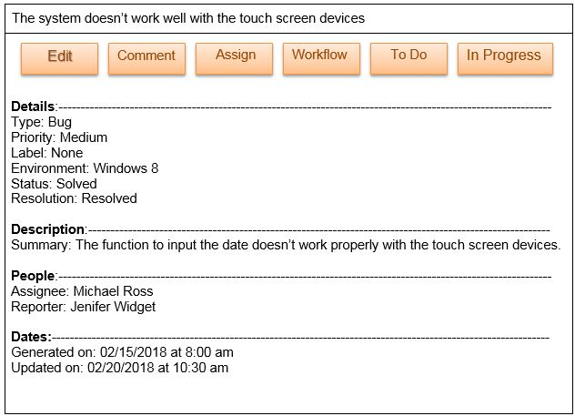
Error Screen: The date input function doesn’t work for touch screen devices By Karan Nayee
Darshan Nayee, Karan Nayee, Jasmine Buttar
Csc225-01
Slide Number-24
December 13th, 2017

Slide 26
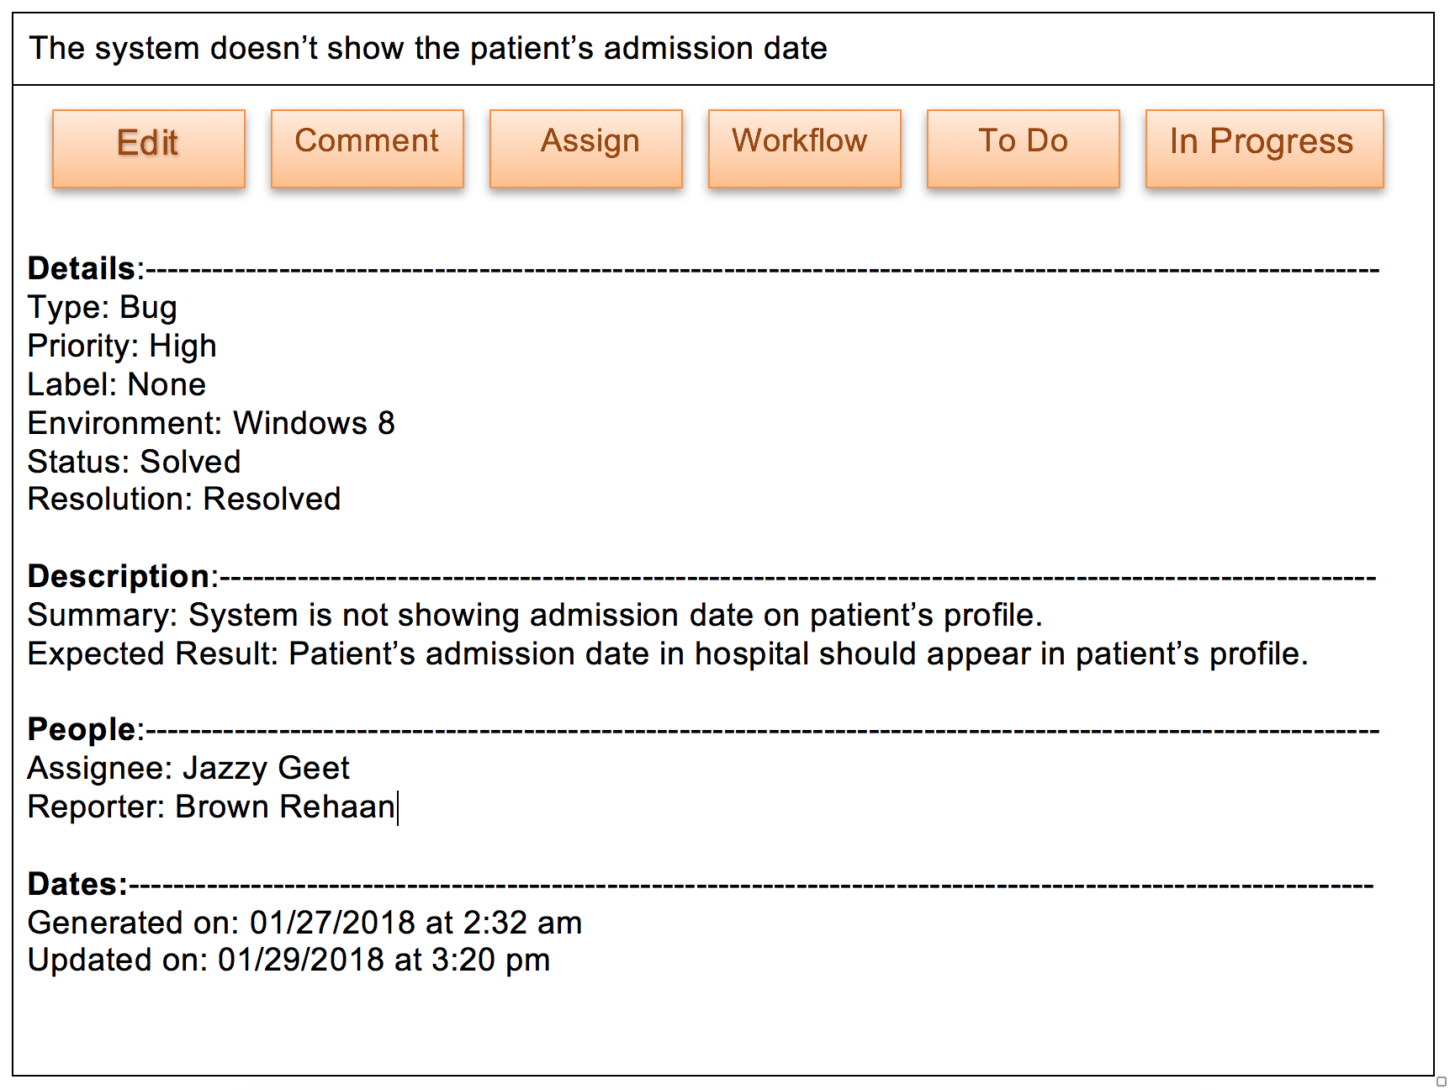
Error Screen: Patient’s Admission Date Missing By Darshan Nayee
Darshan Nayee, Karan Nayee, Jasmine Buttar
Csc225-01
Slide Number-25
December 13th, 2017

Slide 27
Conclusion:
Following conclusions can be deduced from the Patient Record System Project:
> Automation of the entire system improves the efficiency.
> It provides a friendly graphical user Interface which proves to be better when compared to the existing system.
> It gives appropriate access to the authorized users depending on their permissions.
> It effectively overcomes delay in communications.
> Updating information becomes easier with the Patient Record System.
> System security, data security and reliability are striking features.
> The system has adequate scope for modification in future if necessary.
Darshan Nayee, Karan Nayee, Jasmine Buttar
Csc225-01
Slide Number-26
December 13th, 2017

